Slide 1

Careers In IT

Slide 2








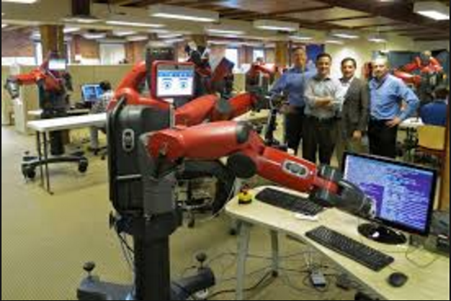

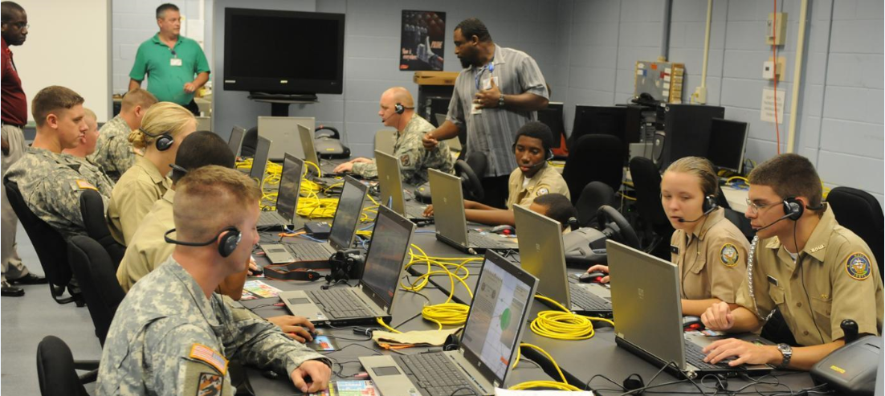
Job Opportunities
Notes:
2

Slide 3



Minimal IT Knowledge Jobs
And more?
MCA
B.Tech
M.Sc
Computer Programmer
Quality Assurance Engineer
Computer Systems Analyst
Information Security Analyst
Computer Information and Research Scientist

Slide 4







Freelancing
Notes:
4

Slide 5

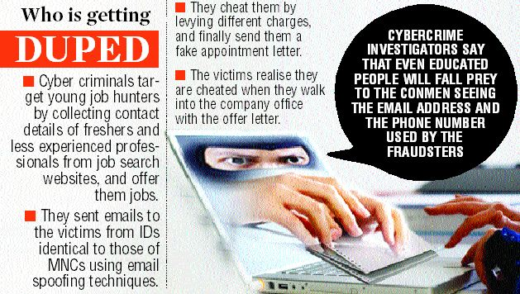
Hoax Mails on Job Offers
Notes:
5

Slide 6

Genuine Job Sites
www.Naukri.com
www.Timesjobs.com
www.Monsterindia.com
www.hiree.com
www.ipsrjobs.com
Notes:
6

Slide 7

A marketing statement that highlights your capabilities and demonstrates what you bring to the job
Personal attributes that will help you to transition into the work environment
Any achievements, commendations or awards you received at high school that show you are honest and reliable
Any volunteer placements that demonstrate your willingness to contribute to the community

Slide 8
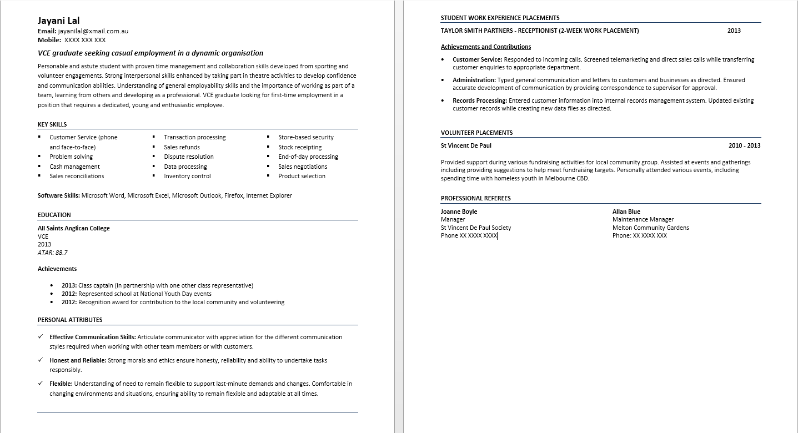
Sample

